Slide 1

Bus reservation System
Submitted by: Arvin, Akhilesh, Aravind
OOP - C++
mini project

Slide 2

Abstract
Traveling is a large growing business in India and other countries. Travel industry is evolving day to day. As the industry evolves the need to digitalize all the transactions becomes need of the hour. Bus reservation system deals with maintenance of records of details of each passenger who had reserved a seat for a journey. It also includes maintenance of information like schedule and details of each bus.
C++ Project
OOPs

Slide 3

PROBLEM STATEMENT
This is a simple Bus Reservation Management System programmed using C++. This program allows you to add bus details, then you can reserve a bus seat according to vacant seat available. One can check for list for vacant seats in a bus. It also allows you to see the available bus for now. This is a simple implementation of C++ code using class and structure.
OOPs

Slide 4

OBJECTIVES OF THE PROJECT
The main objectives of Bus Reservation Management System is to manage the details of the bus reservations, available seats, destination, customer details.
This project provides the better work efficiency, security, accuracy, reliability, feasibility. The error occurred could be reduced to nil and working conditions can be improved.
OOPs

Slide 5
SYSTEM REQUIREMENTS
Details of requirements in project
Hardware Configuration:
Software Specification:
Computer processor: Intel core i3 (available) or Pentium4 (min)
Hard disk: 70 Gb (available) or 50 GB (min)
RAM: 4 Gb (available) or 514 Mb (min)
Operating system: Windows XP or above
Language used: C++
Database: NA
Server: NA
OOPs

Slide 6
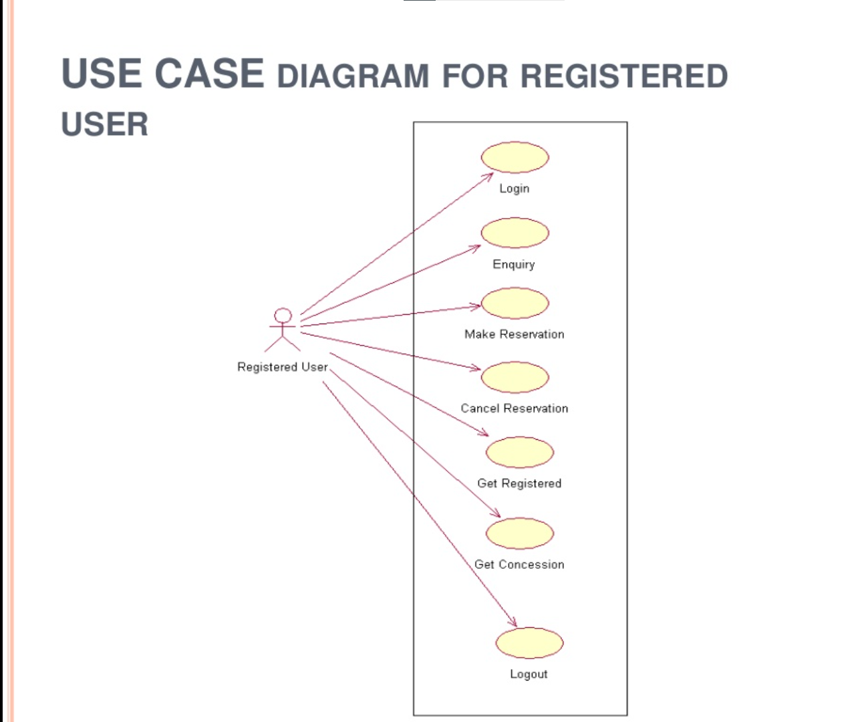
SYSTEM DESIGN
OOPs

Slide 7
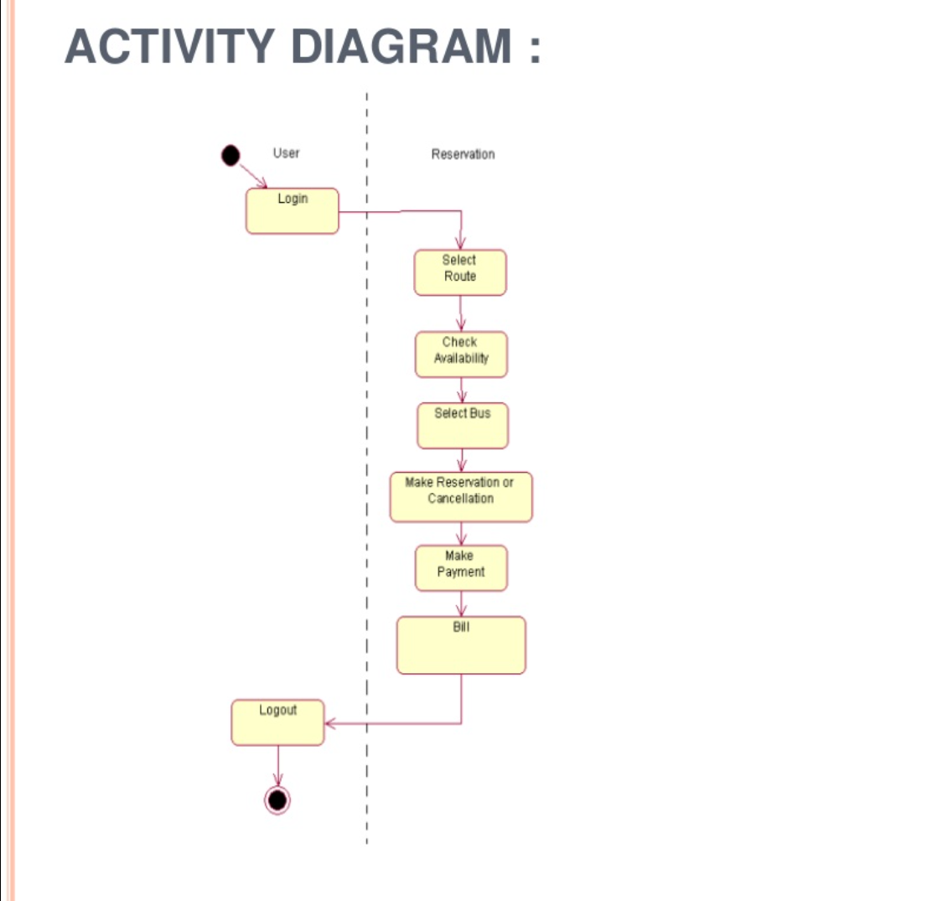
SYSTEM DESIGN
OOPs

Slide 8
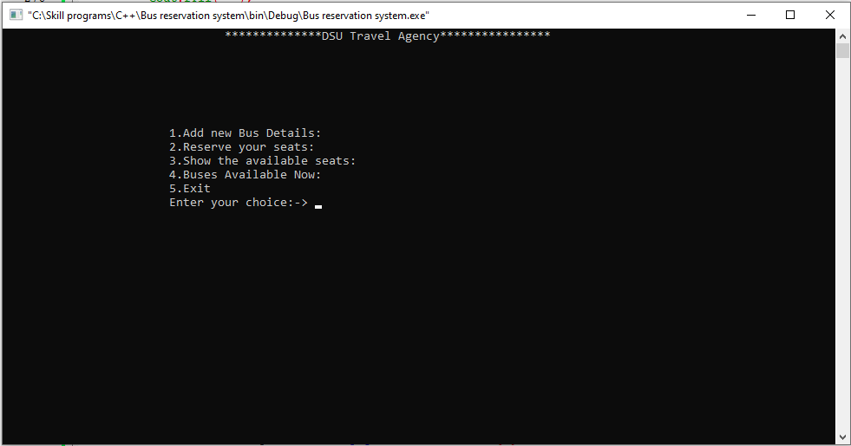
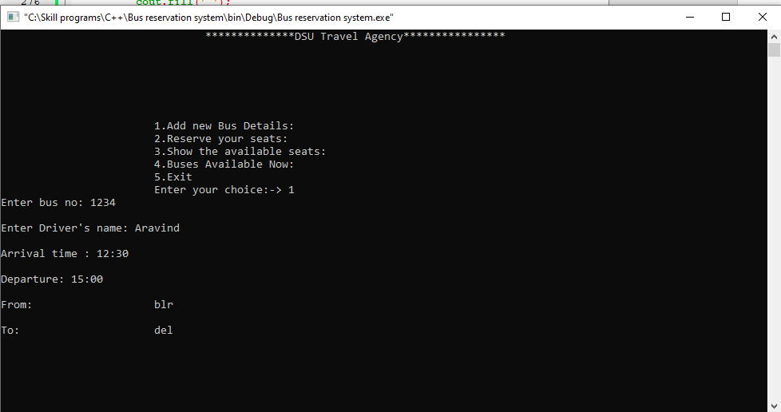
RESULTS:
Main menu
Bus Entry details:
OOPs

Slide 9
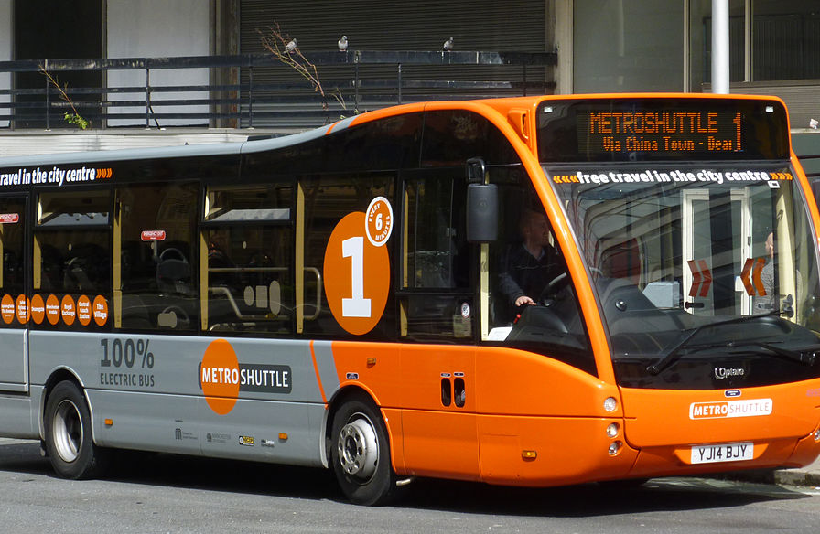

Conclusion
DSU Travels is a bus reservation system which provides Bus Reservation
This system is user friendly and accurate
This system is efficient in reservation
No hidden Cost in fares.
OOPs

Slide 10



Thank You
Arvin Pradhan - ENG17CS0038
Akhilesh S Bhat – ENG18CS0025
A.K. Aravind - ENG18CS0003
OOPs

